Slide 1
Effective Approaches to Attention-based Neural Machine Translation
18/11/10
김보섭

Slide 2
Agenda
Introduction
Neural Machine Translation
Attention-based Model
Global Attention
Local Attention
Input-feeding Approach
Experiments
Analysis
Conclusion

Slide 3
Introduction
본 논문에서는 Neural Machine Translation에서 활용할 수 있는 단순하면서도 매우 효과적인 두 가지의 attentional mechanism을 제안함
Global approach : all source words are attended
→ Global Attention
Local approach : only a subset of source words are considered
→ Local Attention

Slide 4
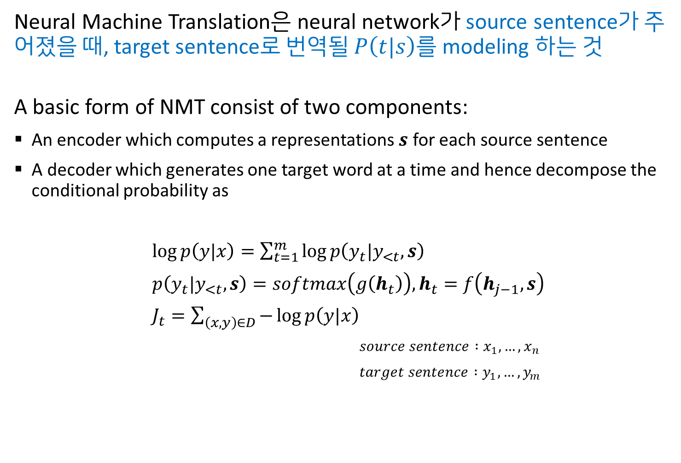
Neural Machine Translation
Neural Machine Translation은 neural network가 source sentence가 주어졌을 때, target sentence로 번역될 $P\left(t|s\right)$를 modeling 하는 것
A basic form of NMT consist of two components:
An encoder which computes a representations $s$ for each source sentence
A decoder which generates one target word at a time and hence decompose the conditional probability as
$\log{p\left(y|x\right)}=\sum_{t=1}^{m}{\log{p\left(y_{t}|y_{<t},s\right)}}$
$p\left(y_{t}|y_{<t},s\right)=softmax\left(g\left(h_{t}\right)\right), h_{t}=f\left(h_{j−1},s\right)$
$J_{t}=\sum_{\left(x,y\right)∈D}{−\log{p\left(y|x\right)}}$
$source sentence :x_{1},…,x_{n}$
$target sentence :y_{1},…,y_{m}$

Slide 5
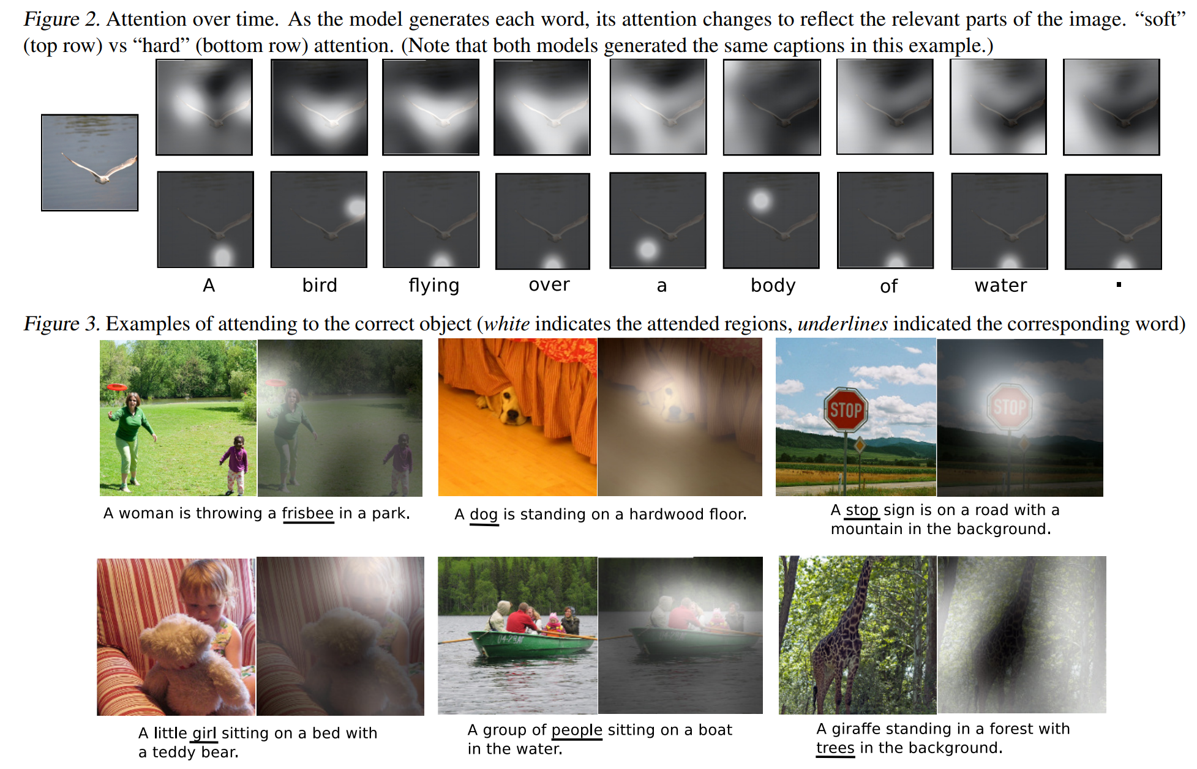
Attention-based Models
일반적으로 neural net을 training하는 관점에서의 attention은 서로 다른 두 modality의 alignment를 neural net이 배우게 하는 것
Show, Attend and Tell: Neural Image Caption Generation with Visual Attention (https://arxiv.org/abs/1502.03044)

Slide 6
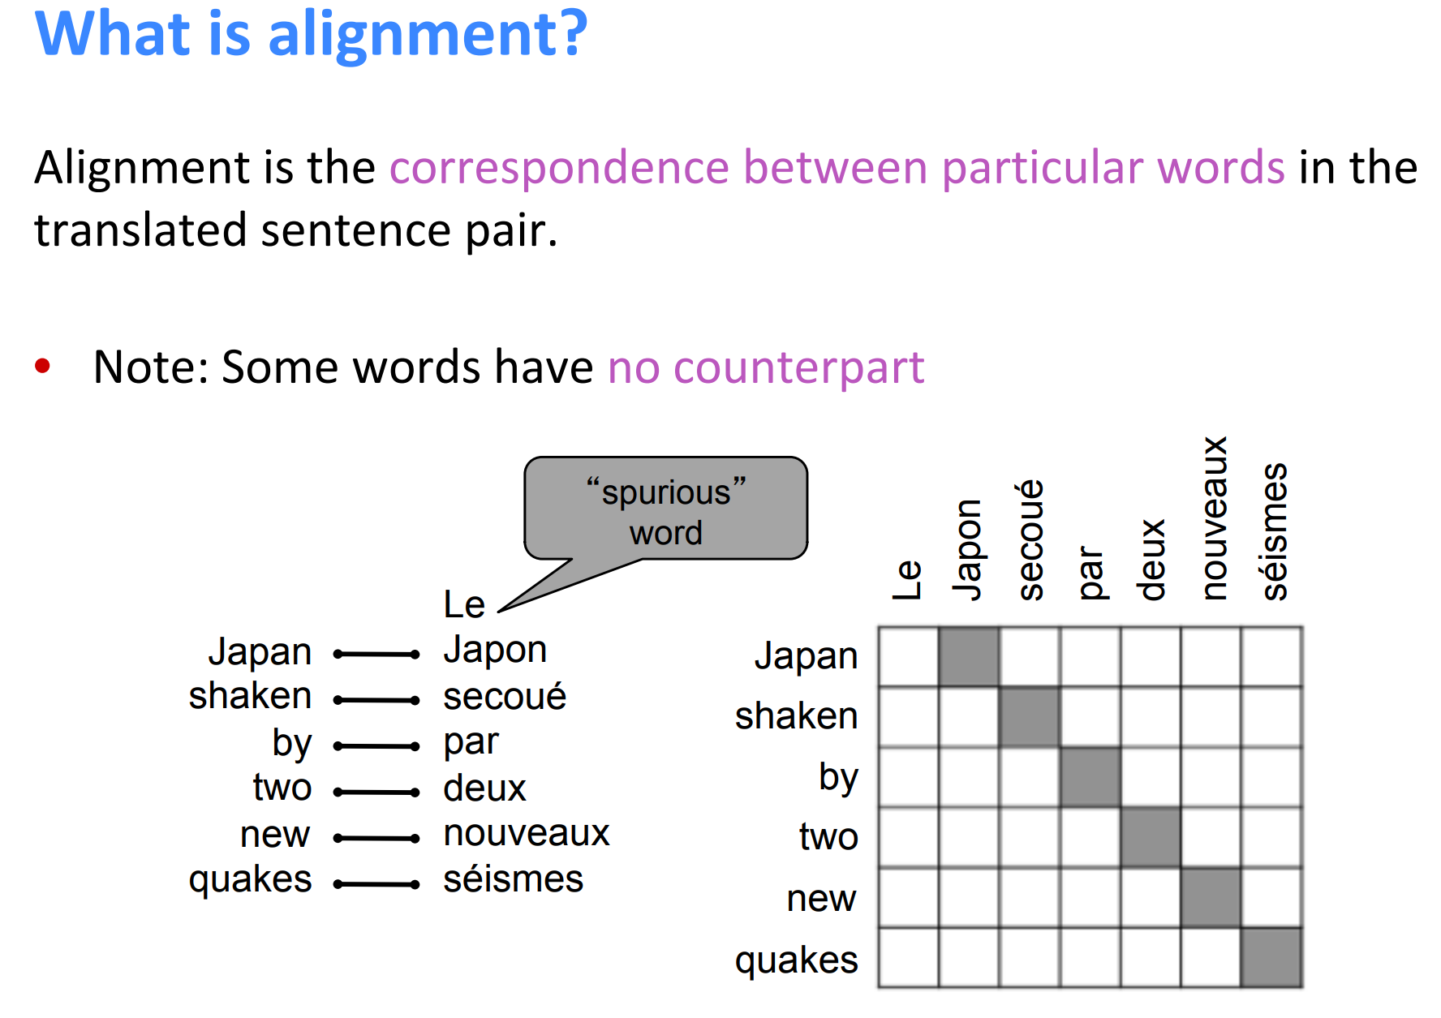
Attention-based Models
Neural Machine Translation에서의 attention은 source sentence와 target sentence의 alignment를 neural net이 배우게 하는 것
http://web.stanford.edu/class/cs224n/lectures/lecture10.pdf

Slide 7
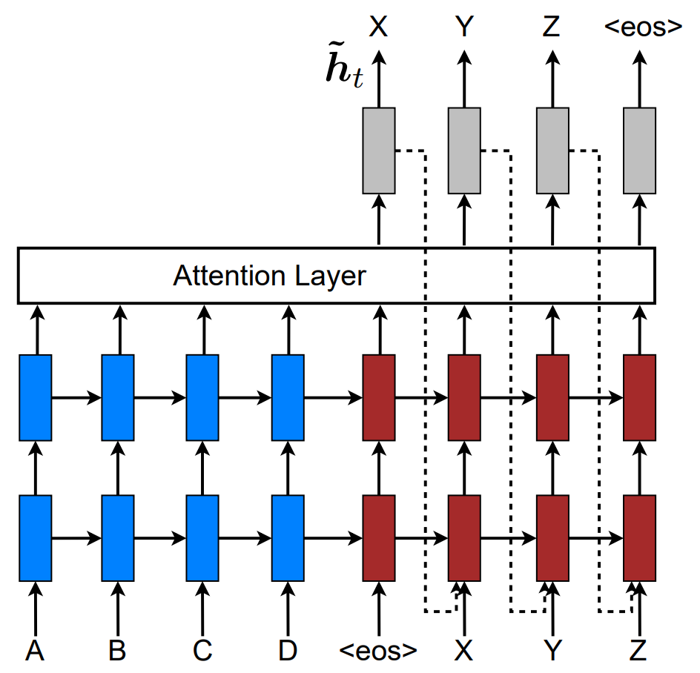
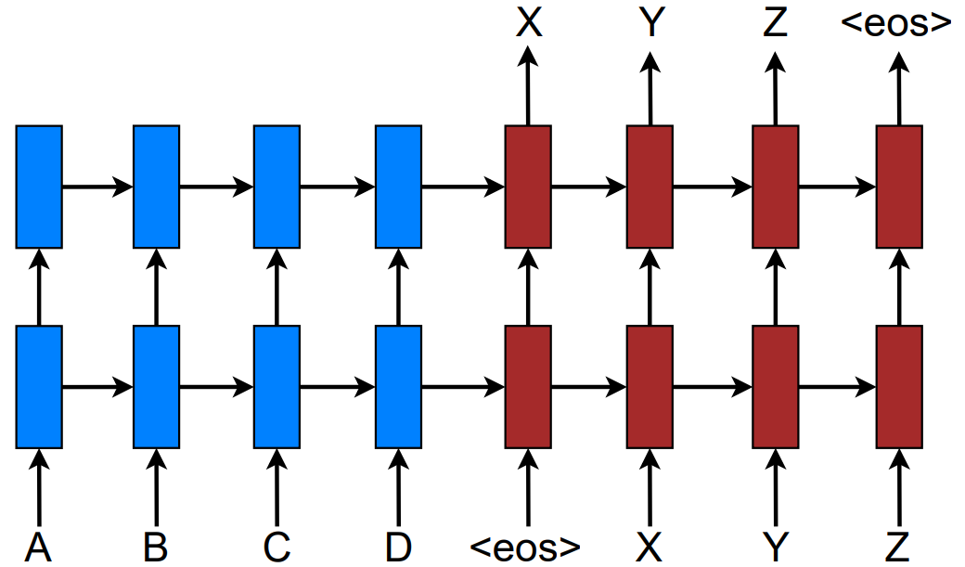
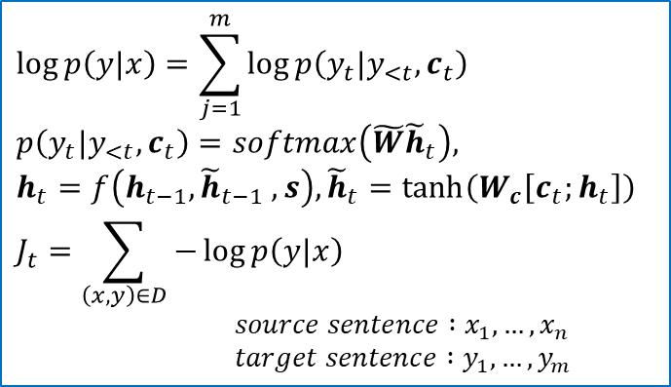
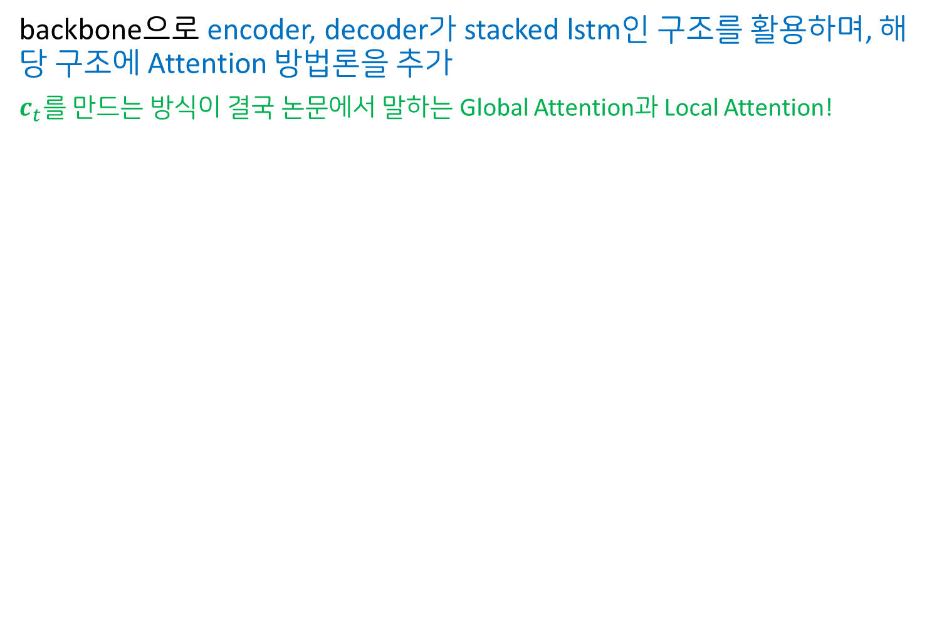
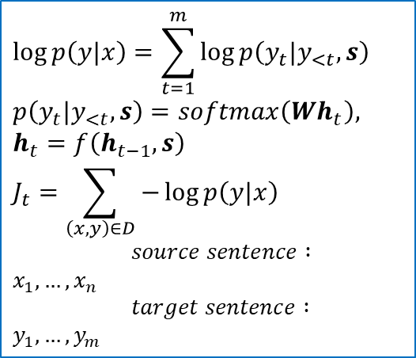
Attention-based Models
backbone으로 encoder, decoder가 stacked lstm인 구조를 활용하며, 해당 구조에 Attention 방법론을 추가
$c_{t}를$ 만드는 방식이 결국 논문에서 말하는 Global Attention과 Local Attention!
$$\log{p\left(y|x\right)}=\sum_{t=1}^{m}{\log{p\left(y_{t}|y_{<t},s\right)}}$$
$$p\left(y_{t}|y_{<t},s\right)=softmax\left({Wh}_{t}\right),$$
$$h_{t}=f\left(h_{t−1},s\right)$$
$$J_{t}=\sum_{\left(x,y\right)∈D}{−\log{p\left(y|x\right)}}$$
$source sentence :x_{1},…,x_{n}$
$target sentence :y_{1},…,y_{m}$
$$\log{p\left(y|x\right)}=\sum_{j=1}^{m}{\log{p\left(y_{t}|y_{<t},c_{t}\right)}}$$
$$p\left(y_{t}|y_{<t},c_{t}\right)=softmax\left(\tilde{W}{\tilde{h}}_{t}\right),$$
$h_{t}=f\left(h_{t−1},{\tilde{h}}_{t−1} ,s\right), {\tilde{h}}_{t}=\tanh\left(W_{c}\left[c_{t};h_{t}\right]\right)$
$$J_{t}=\sum_{\left(x,y\right)∈D}{−\log{p\left(y|x\right)}}$$
$source sentence :x_{1},…,x_{n}$
$target sentence :y_{1},…,y_{m}$

Slide 8
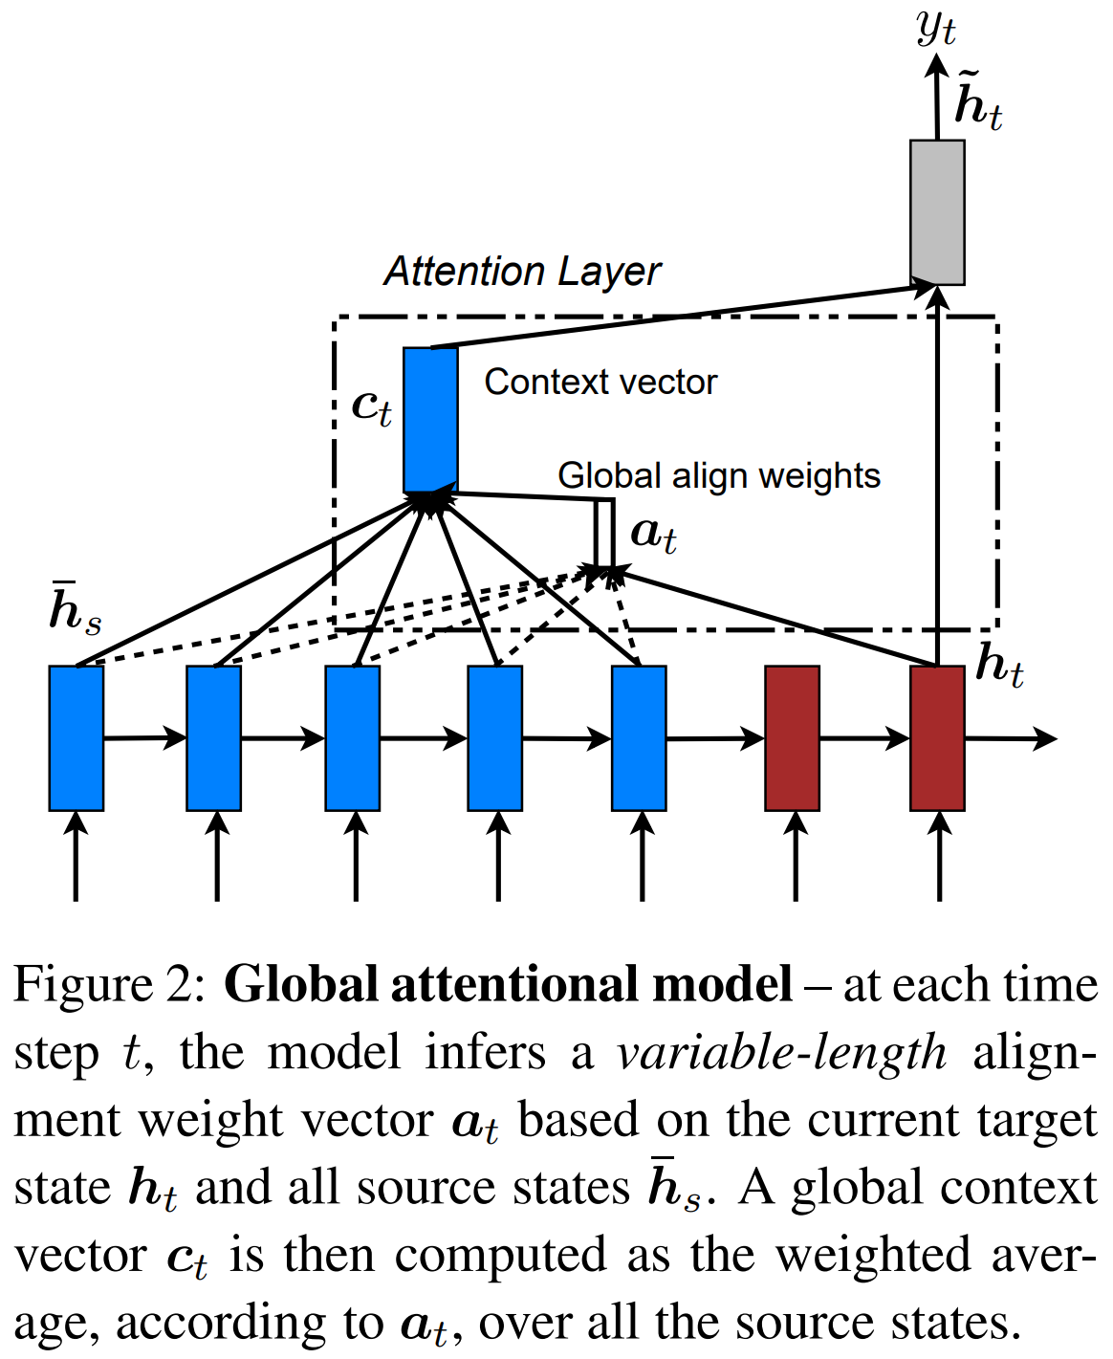
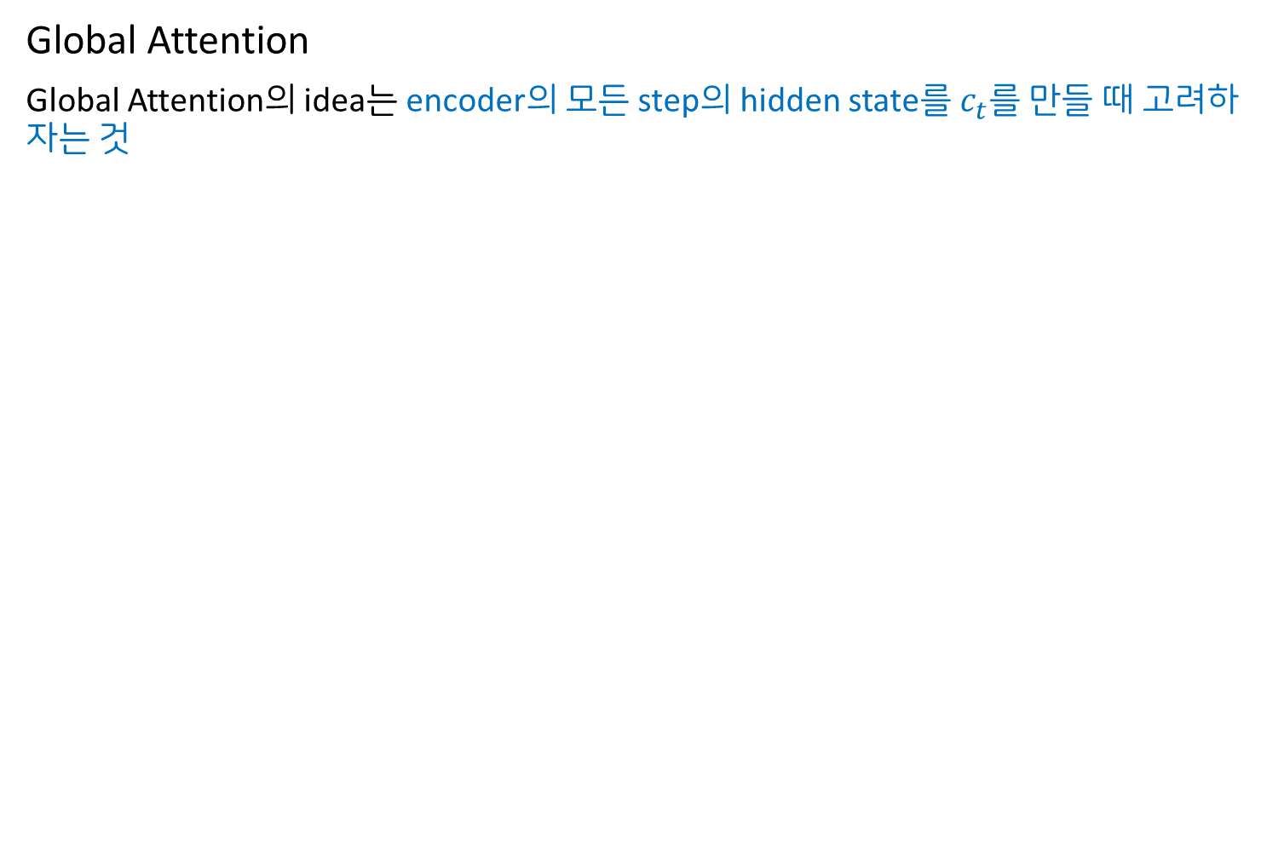
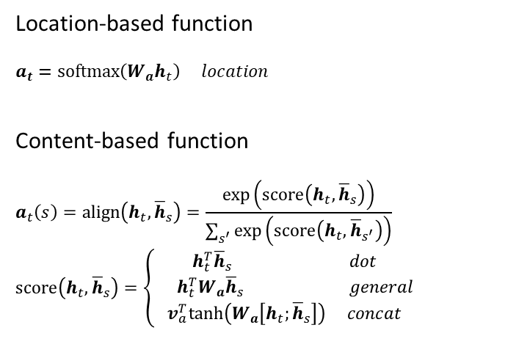
Attention-based Models
Global Attention
Global Attention의 idea는 encoder의 모든 step의 hidden state를 $c_{t}$를 만들 때 고려하자는 것
Location-based function
$$a_{t}=softmax\left(W_{a}h_{t}\right) location$$
Content-based function
$$a_{t}\left(s\right)=align\left(h_{t},{\overline{h}}_{s}\right)=\frac{\exp\left(score\left(h_{t},{\overline{h}}_{s}\right)\right)}{\sum_{s^{′}}{\exp\left(score\left(h_{t},{\overline{h}}_{s^{′}}\right)\right)}}$$
$$score\left(h_{t},{\overline{h}}_{s}\right)=\left\{\begin{matrix}h_{t}^{T}{\overline{h}}_{s} dot \\ \begin{matrix} & h_{t}^{T}W_{a}{\overline{h}}_{s} general\end{matrix} \\ v_{a}^{T}tanh\left(W_{a}\left[h_{t};{\overline{h}}_{s}\right]\right) concat\end{matrix}\right.$$

Slide 9
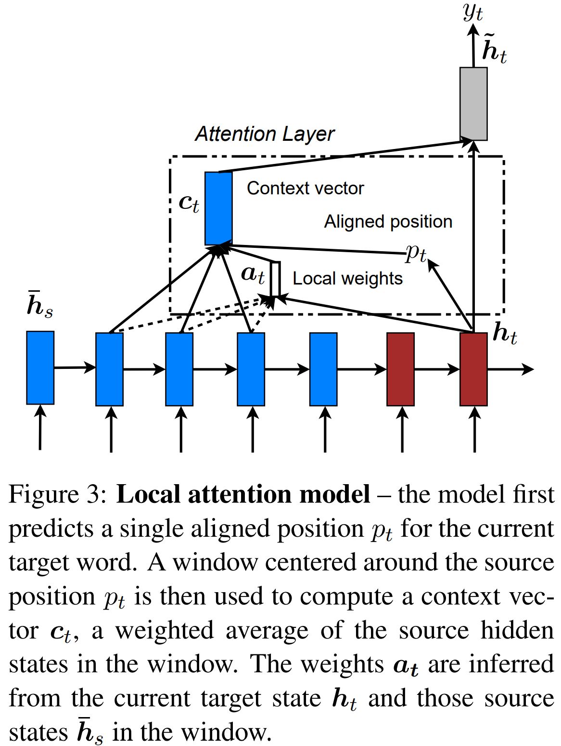
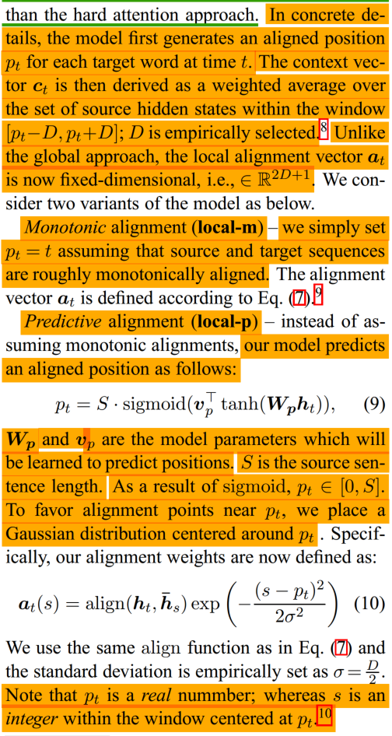
Attention-based Models
Local Attention (1/2)
Global attention의 경우 source sentence가 길어지면 translate하기가 impractical, expensive해지는 문제가 발생 → source sentence의 subset만 고려하는 것

Slide 10
Attention-based Models
Local Attention (2/2)
Global attention의 경우 source sentence가 길어지면 translate하기가 impractical, expensive해지는 문제가 발생 → source sentence의 subset만 고려하는 것

Slide 11
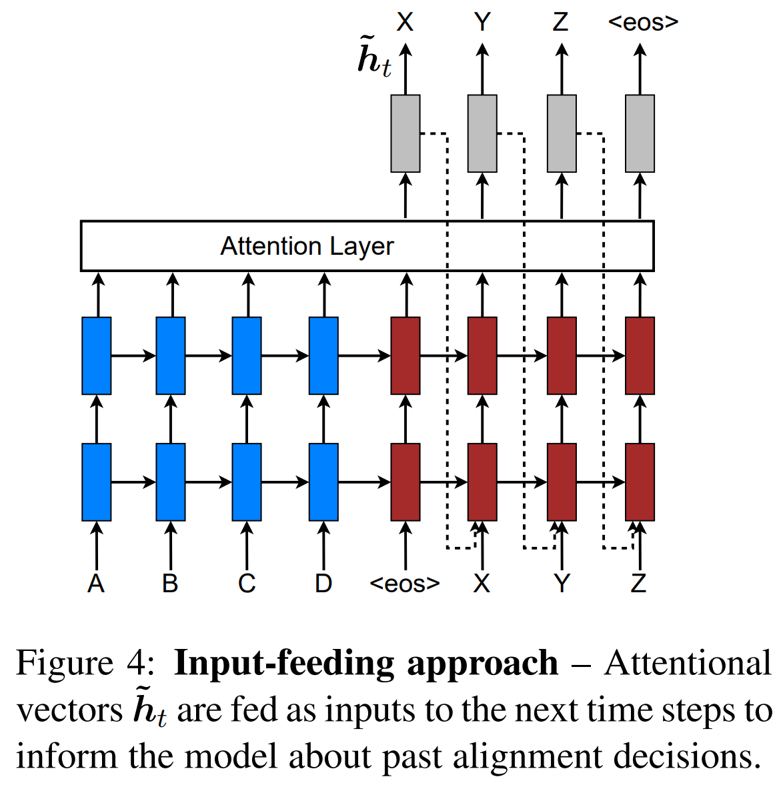
Attention-based Models
Input-feeding Approach
Global Attention, Local Attention은 time step마다 independent 하게 결정되므로 suboptimal → suboptimal을 최대한 줄이기 위해 이전 step의 attention 정보를 전달

Slide 12
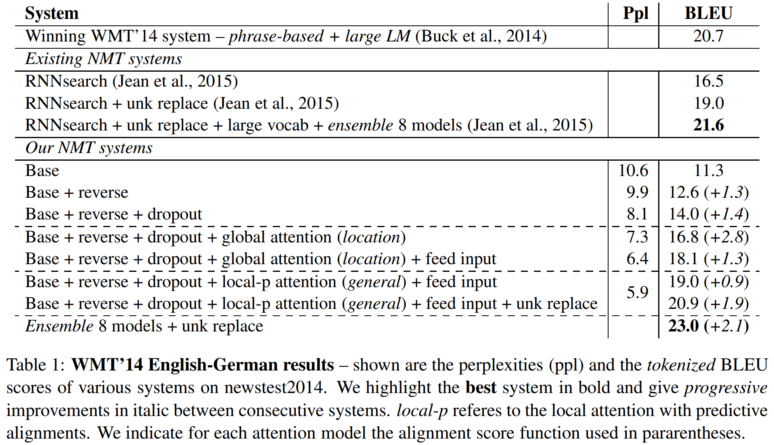
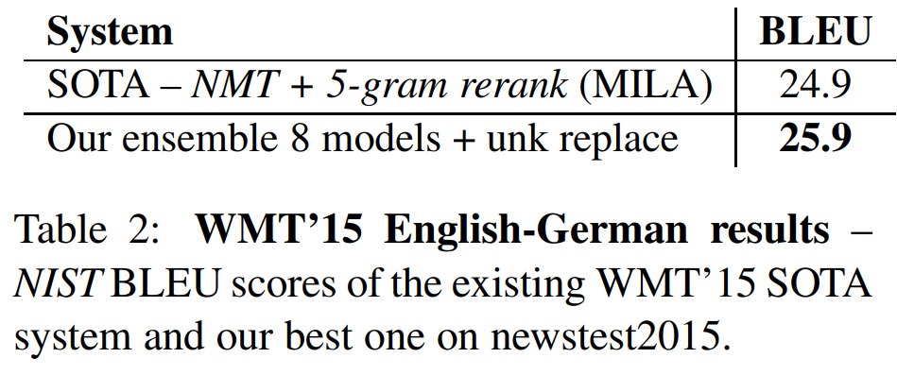
Experiments
English-German Results

Slide 13
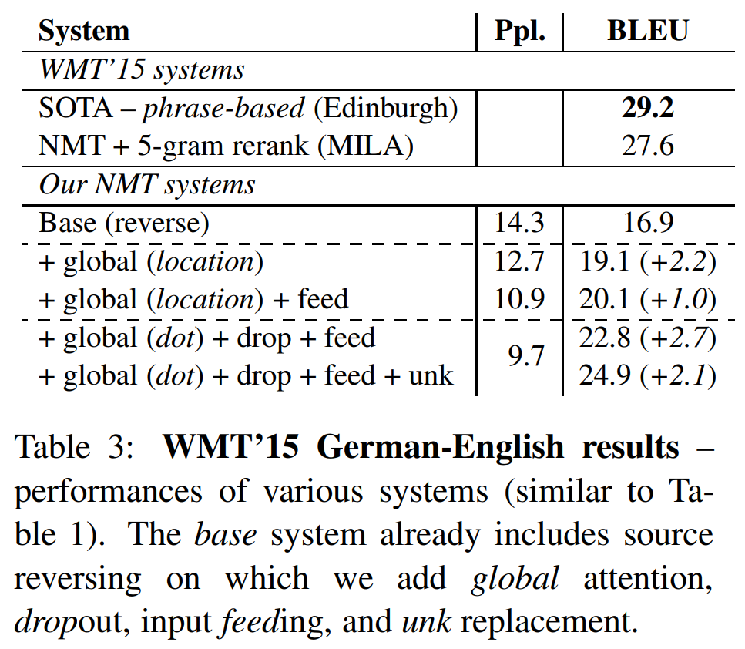
Experiments
German-English Results

Slide 14
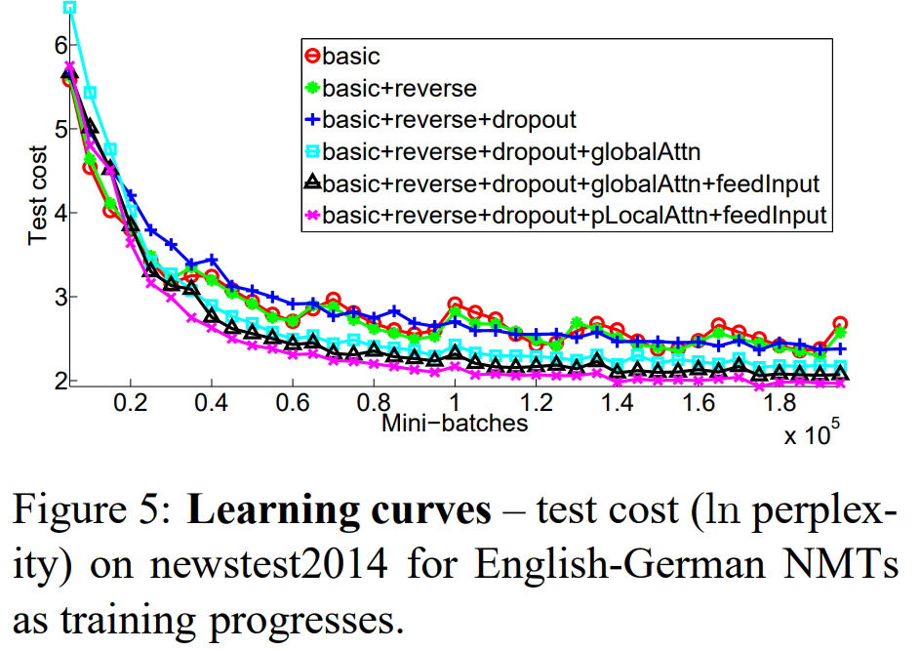
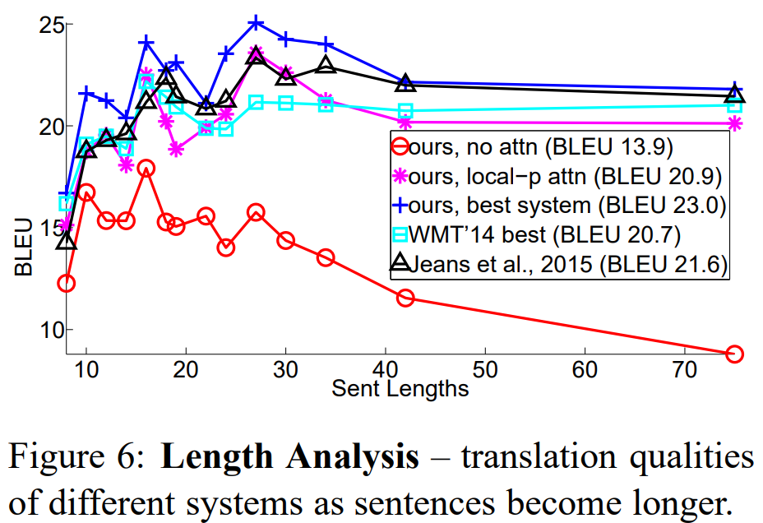
Analysis
Learning curves & Effects of Translating Long Sentences
제안한 Attention mechanism이 적용된 NMT가 그렇지 않은 것보다 학습의 수렴속도가 빠르며, long sentences를 처리하는데 효과적임을 알 수 있음

Slide 15
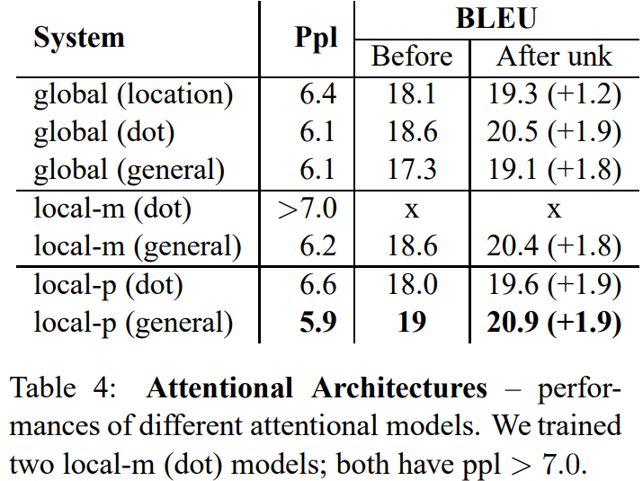
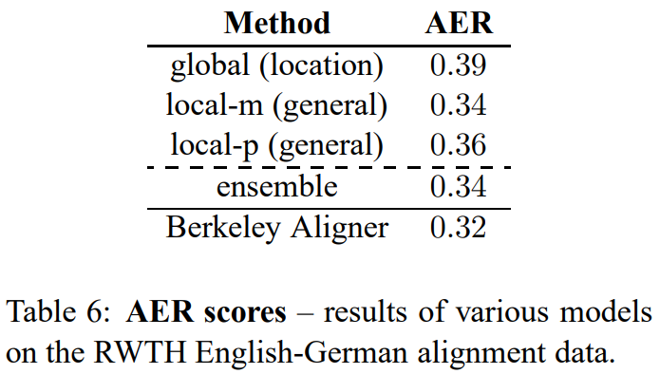
Analysis
Choices of Attentional Architectures & Alignment Quality (1/2)

Slide 16
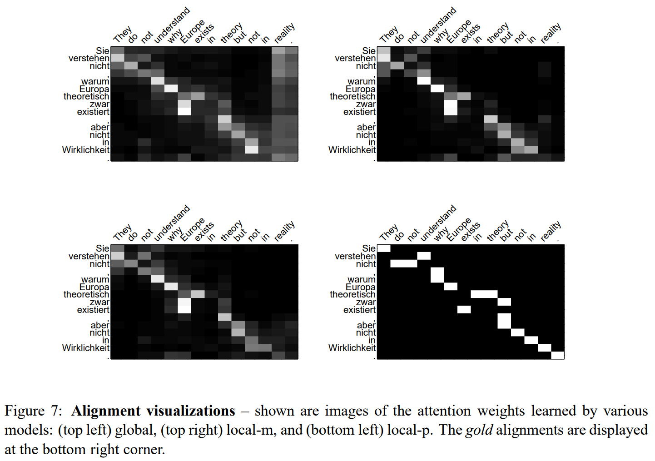
Analysis
Choices of Attentional Architectures & Alignment Quality (2/2)

Slide 17
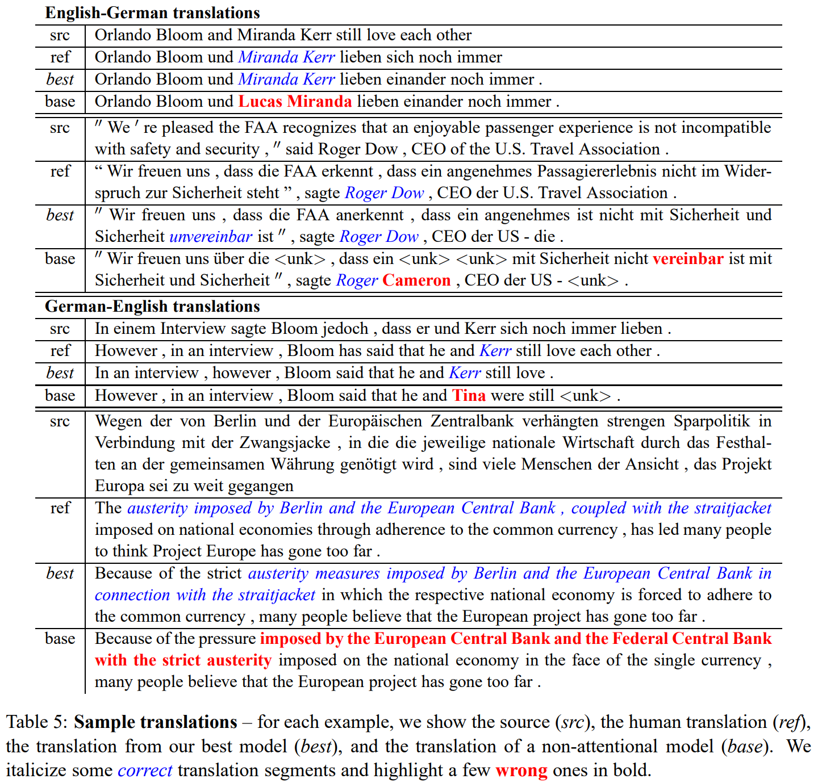
Analysis
Sample Translations

Slide 18

Conclusion & QnA
NMT에 적용할 수 있는 attentional mechanism으로 Global approach와 Local approach를 제안하고, WMT’14, WMT’15에서 SOTA임을 확인

